Slide 1
Text Mining
Analysis of a Corpus of Abstracts on Nuclear Plants Safety

Slide 2
Dataset
Characteristics:
1250 abstracts
Abstracts | Title | Author | Year
Although adequate levels of nuclear safety have been attained, the societal and institutional ap.. | Commentary on the cost of nuclear safety | Mariani, L.P. | 1991
This paper discusses how corporate nuclear safety committees use the principles of self-assessme... | Nuclear utility self-assessment as viewed by the corporate nuclear safety committee | Corcoran, W.R. | 1992
The political changes in Europe broadened the scope of international nuclear safety matters cons... | The use of probabilistic safety assessments for improving nuclear safety in Europe | Birkhofer, A. | 1992
In 1988, responding to a recommendation by the Inspector at the Sizewell B Public Inquiry, the H.. | The ’tolerability’ of nuclear risk? | Barker, F | 1992
Reporting the words «nuclear safety»
English journal articles
From the INIS repository

Slide 3
Data Preprocessing
Steps:
1
The punctuation is removed
Site or multi-unit (MU) risk assessment has been a major issue in the field of nuclear safety study since the Fukushima accident in 2011. There have been few methods or experiences for MU risk assessment because the Fukushima accident was the first real MU accident and before the accident, there was little expectation of the possibility that an MU accident will occur. In addition to the lack of experience of MU risk assessment...
2
The documents are tokenized
3
The documents are filtered for stopwords
‘site’, ’multi’, ’unit’, ’mu’, ’risk’, ’assessment’, ’major’, ’issue’, ’field’, ’nuclear’, ’safety’, ’study’, ’since’, ’fukushima’, ’accident’, ’2011’, ’method’, ’experience’, ’mu’, ’risk’, ’assessment’, fukushima’, ’accident’, ’first’, ’real’, ’mu’, ’accident’, ’accident’, ’little’, ’expectation’, ’possibility’, ’mu’, ’accident’, ’occur’, ’addition’, ’lack’, ’experience’, ’mu’, ’risk’, ’assessment’...
4
The tokens are lemmatized

Slide 4
Corpus Overview
Polarity:
Highest score: 0.0799180751846193. The program of the improvement of nuclear safety in Eastern Europe offers both the Electricity Sector and the Spanish Nuclear Industry an opportunity to apply their wide technological capabilities and to contribute to strengthening of the nuclear option, which is perceived as being of fundamental importance to ensure the supply of electrical energy that will be demanded by the industrialized societies in the medium and log term.
+
Lexicon-based approach: SentiWordNet
0.015 out of 1
Lowest score: -0.056682266356339. The recent U.S. Department of Energy (DOE) nuclear safety policy establishes safety goals, which require that the risk to an average individual for prompt fatalities that might result from accidents should not exceed 0.1% of the sum of prompt fatalities resulting from other accidents and the risk to the population for cancer fatalities that might result from operations should not exceed 0.1% of the sum of all cancer fatality risks resulting from all other causes. To demonstrate that these safety goals are met, each DOE site will be required to evaluate the expected frequencies of occurrence and the corresponding radiation effects for all potential accident scenarios. Also required, for evaluation purposes, is that individuals are assumed to be located within a mile of the site boundary for prompt fatalities and 10 miles for latent cancer fatalities. Most available computer codes for population risk assessment from nonreactor accidents are based on calculations made using either centerline or sector-averaged air concentrations. These approaches could be totally inadequate for estimating prompt fatalities from severe accidents with large radioactive releases. This paper describes a comprehensive approach recently developed to estimate more accurately the populations risks from an accidental release of radioactive materials. A sample calculation was made for a hypothetical accident involving the release of part of the contents inside a high-level waste storage tank.
214 negative documents
1036 positive documents
-

Slide 5
Corpus Overview
Terms
Frequency:

Slide 6


Hierarchical Clustering
Functioning
:
$$tfⅈdf\left(t,d,D\right)=\frac{f_{t,d}}{\sum_{t∈d}{f_{t^{′},d}}}\log{\frac{\left|D\right|}{\left|d∈D:t∈d\right|}}$$
$$sⅈm\left(a,b\right)=\frac{a⋅b}{\left\|a\right\|\left\|b\right\|}∈\left[0,1\right]$$
$$\left(x_{k},x_{l}\right)=\arg{min}\left\|x_{r}−x_{s}\right\|,\left(x_{r},x_{s}\right)∈X^{2}$$
Sim(Doc.1, Doc.2)
Doc. 1
[0.01,0,0,0.03,0,0,…,0]
0.4
The Ward’s method is based on the minimum variance criterion
Doc. 2
[0,0.2,0,0.005,0,0,…,0]
Sim(Doc.1, Doc.3)
0.02
1
Documents embedding: term frequency-inverse document frequency
2
Documents similarity: Cosine distance
3
Initialization: each data point as a single cluster (Bottom-up approach)
Merge closest clusters using the Ward’s method
Repeat the previous step untill only one cluster is left

Slide 7
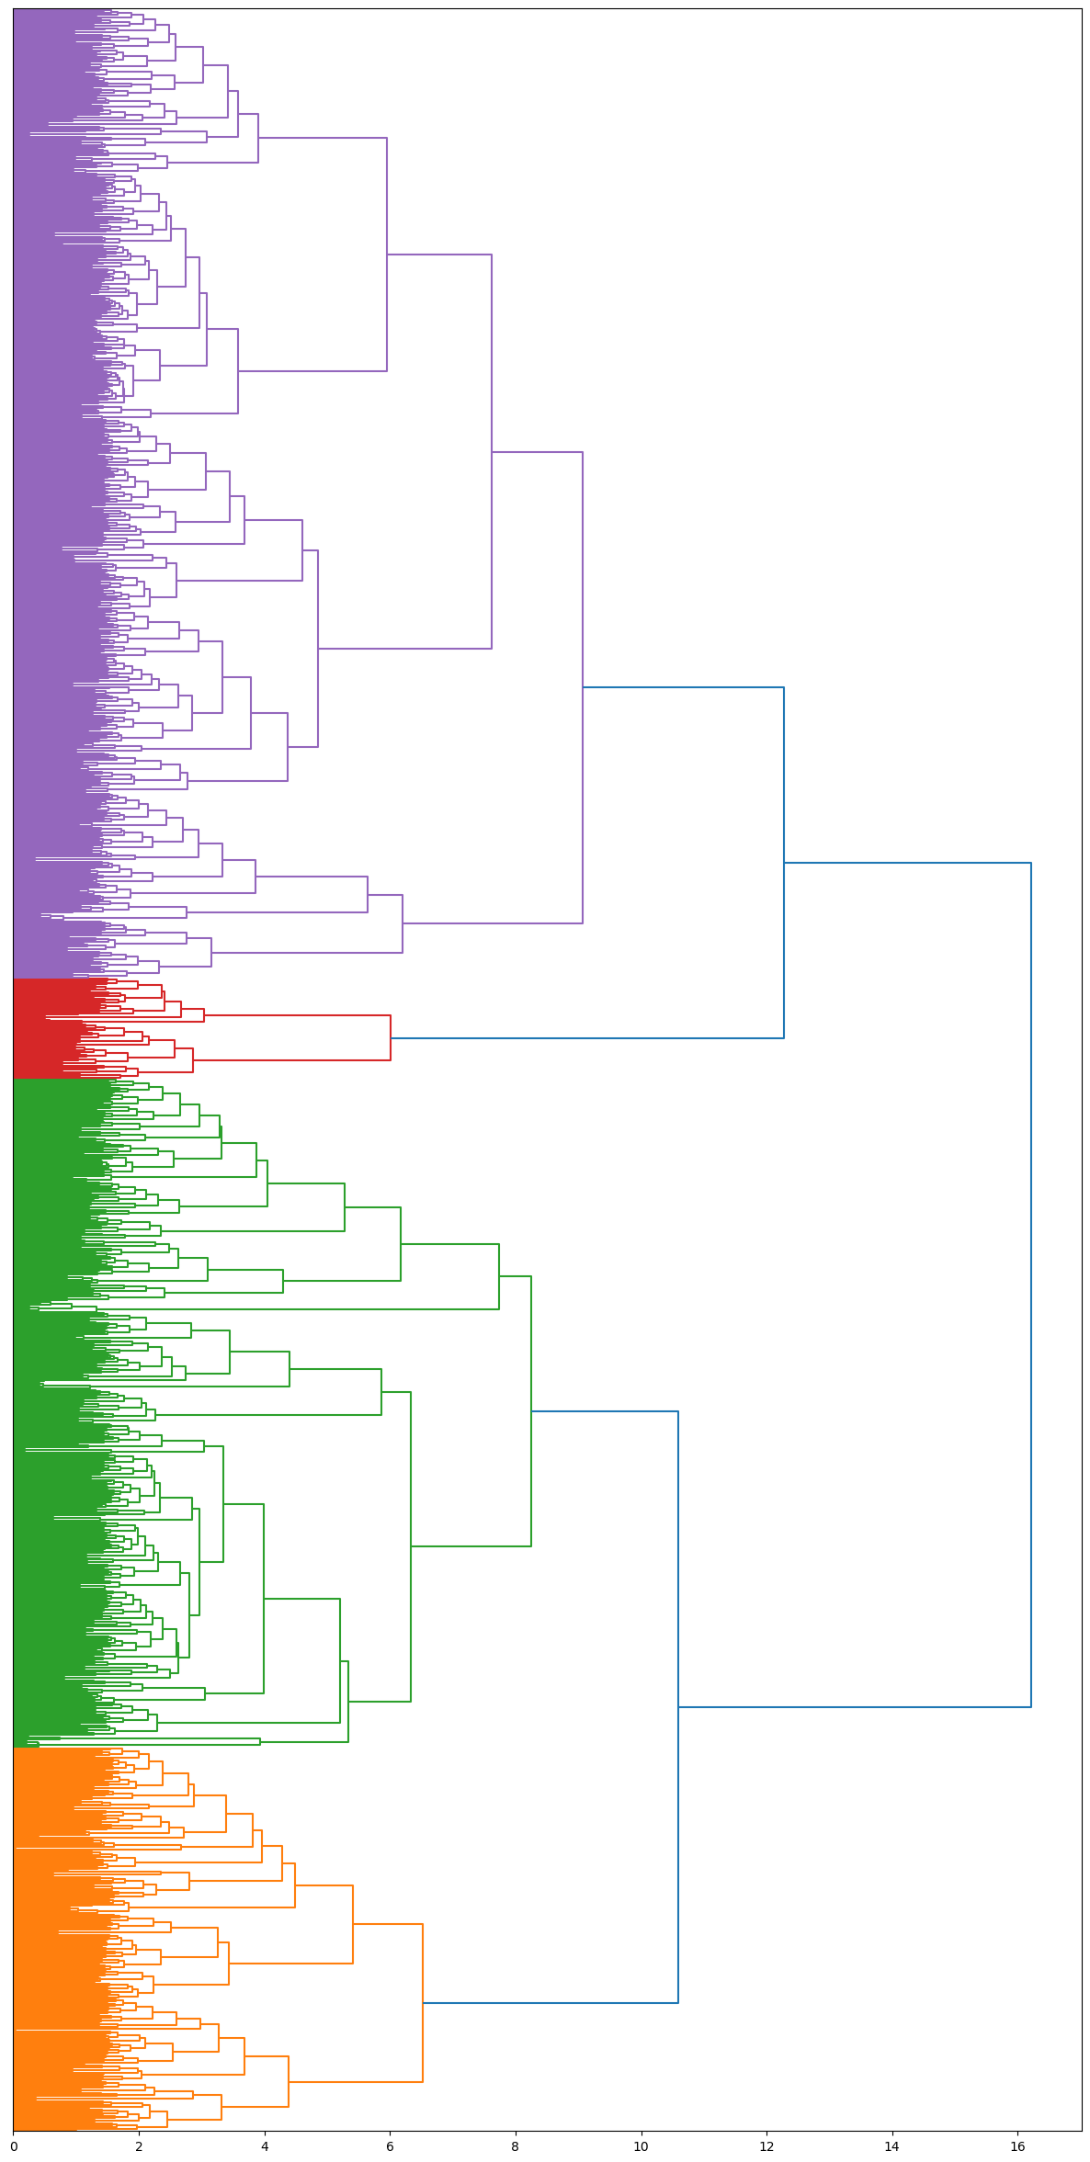
Hierarchical Clustering
Dendrogram:
Frequent Terms | Polarity | Year
neutron, radiation, design, dose, test, water, measurement, flow, heat, research, calculation, experimental, accident, simulation, temperature. | 0.0026 | 2010
cladding, rod, condition, test, burnup, ria, pellet, nsrr, pulse, failure, research, deformation, temperature, irradiation, pcmi | 0.0003 | 2005
radiation, waste, international, protection, regulatory, management, european, convention, state, country, research, culture, programme, regulation, iaea | 0.0037 | 2004
accident, risk, design, public, severe, iaea, management, probabilistic, fukushima, research, development, approach, country, psa, event | 0.0025 | 2008
Dosimetry
Cladding
Int. law and waste
Accident and psa

Slide 8




Latent Dirichlet Allocation
Intuition:
Unseen Doc.
Doc.1
Doc.3
[0.002, 0.01, 0, 0,…,0]
Doc.2
[0, 0, 0.003, 0,…,0.02]
[0.004, 0, 0.02, 0,…,0]
[1,0,0]
[0,0.5,0.5]
[0,1,0]
[0.2, 0.8, 0]
1
Training phase: once given the a priori number of latent topics treated by the corpus, the model detects the topic distributions of documents and the words distribution of topics.
2
Once trained the model is able to classify unseen documents in way completely unsupervised. One application could be the management of large digitial archives.

Slide 9






Latent Dirichlet Allocation
Architecture
:
Due to its intractability an estimation method is required.
It is a generative probabilistic model based on Bayesian theory.
Likelihood
$$p\left(\left.A\right|B\right)=\frac{p\left(\left.B\right|A\right)p\left(A\right)}{p\left(B\right)}∝p\left(\left.B\right|A\right)p\left(A\right)$$
$$p\left(θ,φ_{,}\left.z\right|w,α_{,}β\right)∝p\left(\left.w\right|θ,φ\right)p\left(\left.θ\right|α\right)p\left(\left.φ\right|β\right)p\left(\left.z\right|θ\right)$$
Bayes theorem
Posterior distribution
Prior distributions
$$θ\sim Dir\left(α\right)$$
Document-topics
$$φ\sim Dir\left(β\right)$$
Latent variables
Topic-words
!Exchangeability assumption!
$$z\sim M\left(θ\right)$$
Topic
$$w\sim M\left(φ\right)$$
Word

Slide 10




Latent Dirichlet Allocation
Plate
Notation:
$$β$$
Observed
D-for all the documents
Nd-for all the words of a document
T-For all the topics
$$φ$$
T
$$α$$
z
w
The estimation method employed is the Variational Bayes.
$$θ$$
Nd
D

Slide 11
Latent Dirichlet Allocation
Latent
Topics:
International Law | Dosimetry | Cooling System | Accident
radiation protection waste international agency state management iaea research regulatory programme convention european regulation country radiological environmental national atomic cooperation | neutron radiation dose measurement source measure sample field monitoring standard protection dos value dosimetry detector concentration obtain test parameter developed | test accident water condition heat temperature flow core simulation research experiment rod cladding experimental containment cool transient calculation coolant therma | accident design risk development research issue regulatory event approach public security npp management make need industry standard important support improve

Slide 12



Latent Dirichlet Allocation
Application:
61% Accident
Fuel cladding, the protective shield around nuclear fuel pellets in reactors, is essential for nuclear power plant safety. However, it can pose challenges when compromised, leading to accidents. Fuel cladding serves to contain radioactive materials, ensuring they do not escape into the environment. It also maintains fuel rod structural integrity under extreme conditions. Historical nuclear disasters, like Chernobyl and Fukushima, underscore the importance of fuel cladding. Failures in cladding contributed to the severity of these accidents. Stringent international safety standards, advanced materials, and proactive measures, such as inspections and research, help mitigate fuel cladding-related risks. As the world seeks sustainable energy, nuclear power remains an option. Prioritizing fuel cladding integrity, adhering to safety standards, and continuous research are essential to secure the future of nuclear power while ensuring public safety.
30% Cooling System
9% International Law

Slide 13






Joint Sentiment-Topic Model
Plate
Notation:
It has the same structure as that of LDA but with one additional latent variable modelling sentiments.
$$β$$
Semi-supervised since they are initialized with labelled sentiments.
$$φ$$
S*T
$$α$$
$$θ$$
z
w
The estimation method employed is the Gibbs sampling.
S
l
Nd
π$\sim Dir\left(\text{ϒ} \right)$ Document-sentiments
ϒ
π
D
l$\sim M($π) Sentiment

Slide 14
Joint Sentiment-Topic Model
Latent
Sentiment-Topics:
Intern. Law + | Intern. Law - | Accident + | Accident -
international waste iaea country management european research protection state programme regulatory convention regulation national agency cooperation atomic development act area | design regulatory standard iter component technical inspection program control operating commission maintenance licensing test canadian engineering current operational procedure must | research year technology report issue japan world well period accident unit development environmental start strategy institute cost 2011 document chernobyl | accident risk public event security human factor fukushima culture approach improve fire propose show need important psa npps Impact china

Slide 15


Reversed Joint Sentiment-Topic Model
Plate
Notation:
Model assumptions are reversed: documents as a mixture of topics first and only then as a mixture of sentiments.
$$β$$
Some recent literature suggests that this model works better with more complex documents, where the sentiment is harder to be captured. For example, political speeches or scientific debates as opposed to product reviews.
$$φ$$
S*T
$$α$$
$$θ$$
z
w
T
S
However the results obtained are more in accordance to older literature, assigning JST the primacy over joint sentiment-topic modelling, no matter how explicitly the sentiment is expressed.
l
Nd
ϒ
π
D

Slide 16
References:
Andrea Esuli Stefano Baccianella and Fabrizio Sebastiani. Sentiwordnet 3.0: An enhanced lexical resource for sentiment analysis and opinion mining. Proceedings of the Seventh Inter- national Conference on Language Resources and Evaluation, pages 2200–2204, 2010.
Andrew Y. Ng. David M. Blei and Michael I. Jordan. Latent Dirichlet allocation. Journal of Machine Learning Research, 2003.
Chenghua Lin and Yulan He. Joint sentiment/topic model for sentiment analysis. Proceedings of the 18th ACM conference on Information and knowledge management, pages 375–384, 2009.
Martijn Schoonvelde Max Boiten, Christian Pipal and Gijs Schumacher. Validating the joint sentiment topic model and the reversed joint sentiment topic model on political text. 2019.
Yulan Lin, Chenghua; He and Richard Everson. A comparative study of Bayesian models for unsupervised sentiment detection. The 14th Conference on Computational Natural Language Learning, 2010.

